Slide 1

INTRODUCTION OF MACHINE LEARNING/ DATA SCIENCE IN SUPPLY CHAIN ANALYSIS
Name: Elias Bongani Somba, academic supervisor: T. Farrar, Company Name: Company X, Company supervisor: Audria Allies nee Issacs and Yusrie Sadan

Slide 2
Contents
Introduction
Business Problem
Literature Review
Objective
Methodology
Results & Discussion
Conclusion & Recommendation

Slide 3
Introduction
Most companies use insights gained from data to make decisions about their day to day operations and processes. (Kościelniak and Puto, 2015)
Company X, is no exception to the use of Data.
We can Introduce Data Science/ Machine learning to supply chain analysis.

Slide 4
Introduction
Data Science – “is a concept used to tackle big data and includes data cleansing, preparation, and analysis” (Sasikumar, 2020)
Machine learning – “can be defined as the practice of using algorithms to extract data, learn from it, and then forecast future trends for that topic.” (Sasikumar, 2020)
Supply chain – Supplying of goods from point A to B through supply pipeline.

Slide 5
Business Problem
Everything is done manual like data cleaning, analyzing and building of database. Which is time consuming.
Report is done by weekly bases.
Accuracy of estimated parameters is not always measured.
Proposed solution
Build a predictive model that will estimate lead-time.
Automate cleaning of data by use of R
Automated data insight using R.

Slide 6
Literature Review
Application of machine learning techniques for supply chain demand forecasting (Carbonneau, Laframboise and Vahidov, 2008).
Two Methods:
Machine Learning( Linear Regression)
Forecasting (naïve Forecasting method)
Results
Forecasting was not statistically significant, unlike regression model. Author classified naïve forecast as the worst to use due to lot of errors.

Slide 7
Objectives
Develop a lead-time model using logistic Regression.
Determine whether the Logistic regression model is the ideal model to improve lead-time accuracies within the supply chain.

Slide 8
Methodology
Extracted base data from Company X source systems.
R programming language to cleanse data (imputation ppm).
Data visualization completed on R code to obtain data insights.
Ontime measurement used to estimate dependent variable where y= late indicator.
Independent variables measured against: Country of Origin, Merch Type , Supplier Code and Transport Method(X= Independent variables)

Slide 9
Methodology
Build Regression Model (Logistic Model)
Applied Lasso Methods as a Feature Selection.
Created a matrix with the variables(training of data)
Variable selection using ten-fold cross validation.
Fit our data to get accuracy of predictive score.
Use Decision Tree.
Confuse Matrix

Slide 10
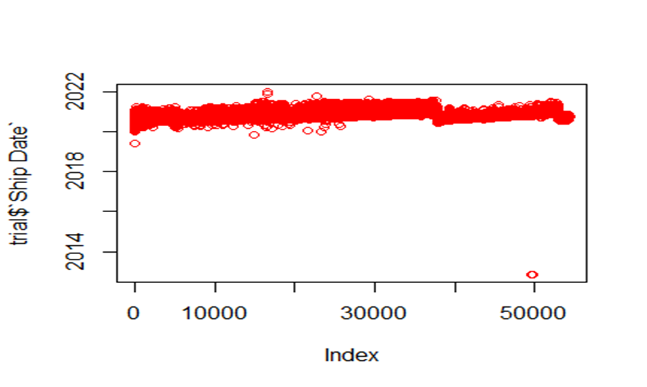
Results & Discussion (data insight)
Ship date

Slide 11
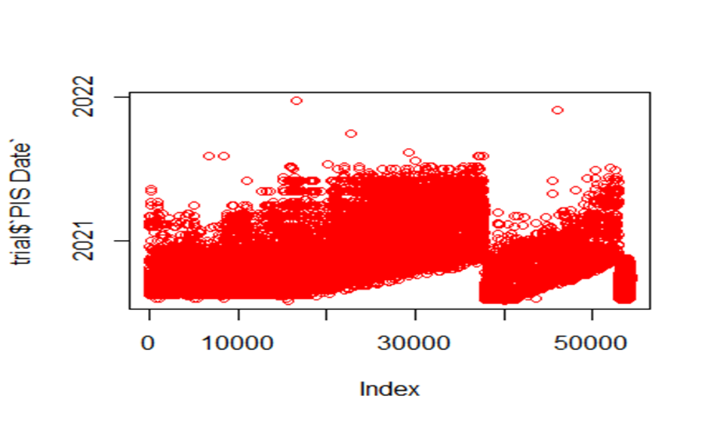
Results & Discussion (data insight)
PIS Date

Slide 12
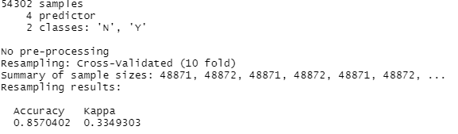
Results (Cross-Validation 10 fold)

Slide 13
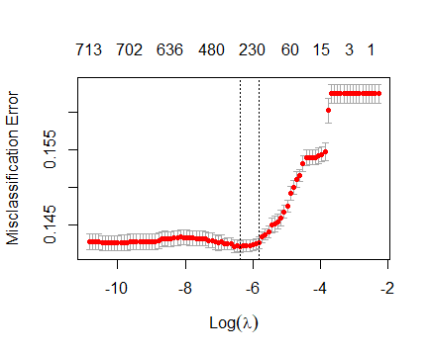
Results (misclassification error)

Slide 14
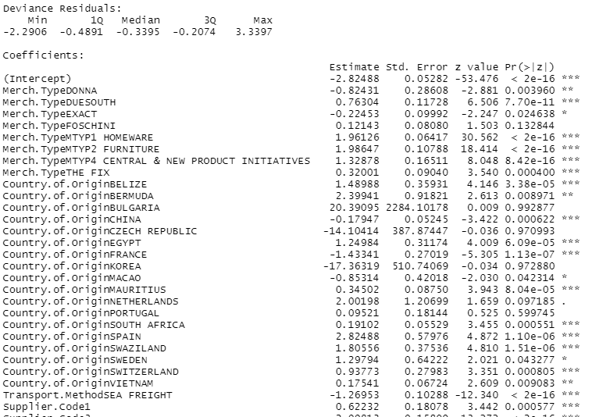
Results (late or not)

Slide 15
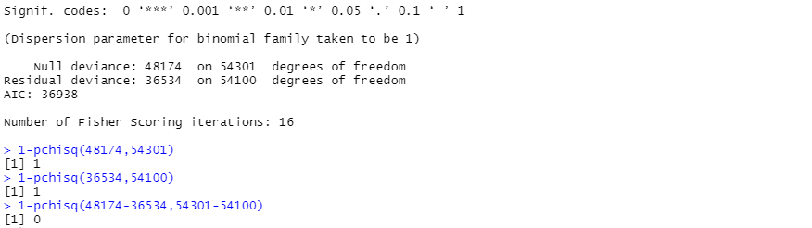
Results( Late or Not)

Slide 16

Results (Cross-validation)

Slide 17
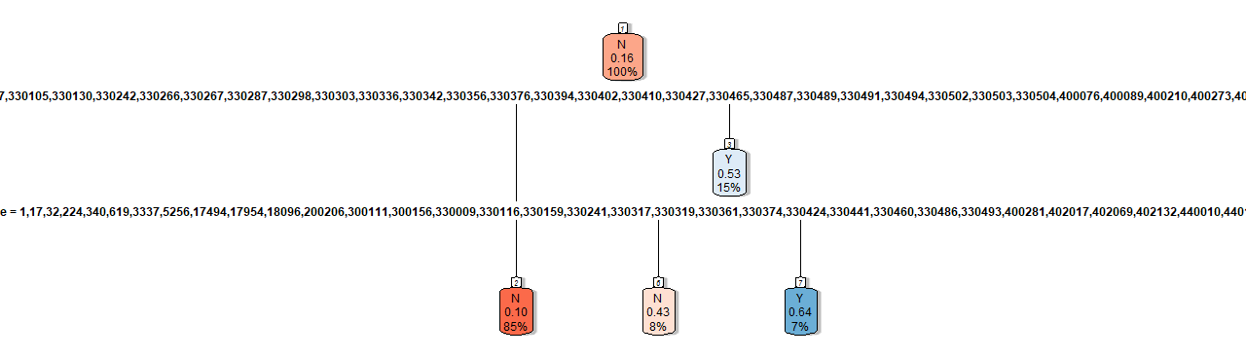
Results (Decision Tree)

Slide 18
Conclusion
Machine learning and Data Science can be a retro-fitted to the supply chain. Various models could be applied throughout the investigation (Cross validation model)
Logistic Model is a good model to be used in Supply Chain (Company X)
It shows high accuracy of predicting a lead-time (on-time measurement)
R codes can be used to clean the Data and provides data insight.

Slide 19
Recommendations
Even though the Logistic model is good, it can also be improved by feeding more data into the model.
Develop a model to provide a time series based on late indicator

Slide 20
References
Carbonneau, R., Laframboise, K. and Vahidov, R., 2008. Application of machine learning techniques for supply chain demand forecasting. European Journal of Operational Research, [online] 184(3), pp.1140-1154. Available at: <https://reader.elsevier.com/reader/sd/pii/S1877050915028835?token=6D4AB0CBA173191381F835E221A7BED7A3F0DEE308B8B4385E2FDA73E035C9C1C7C839E29C39CE617C19772D6871DB8E> [Accessed 28 December 2020].
Sasikumar, S., 2020. Data Science Vs. Data Analytics Vs. Machine Learning: Expert Talk. [online] Simplilearn.com. Available at: <https://www.simplilearn.com/data-science-vs-data-analytics-vs-machine-learning-article#:~:text=Because%20data%20science%20is%20a,machine%20or%20a%20mechanical%20process.> [Accessed 22 January 2021].
Ingle, Y., 2013. 2. [online] Research gate. Available at: <https://www.researchgate.net/publication/342492990_Use_of_Linear_Regression_in_Machine_Learning_for_Ranking> [Accessed 30 October 2020].
JORDAN, J., 2017. Evaluating A Machine Learning Model.. [online] Jeremy Jordan. Available at: <https://www.jeremyjordan.me/evaluating-a-machine-learning-model/> [Accessed 30 October 2020].

Slide 21


Thank YOU!!!!!!

